Slide 1

Research Proposal
By Joseph Kenyatta
Teaching Programming Through Gaming
E46/3939/2019
ICS 410a

Slide 2
Introduction
Nowadays, it is compulsory for students who are enrolled in ICT courses to learn to program. This proposal intends to help them achieve this skill by creating an interactive Hangman game that will teach them programming skills in a way that will enhance their understanding of programming concepts.
The students will be motivated to program as they advance through the levels of the game from simple snippets of code to complex algorithms. They will start from the known to the unknown, thus by the time they are done playing the game, they will be ready to tackle any programming concept without much strain.

Slide 3
Justifications
The game that will be developed will provide a fun and engaging way for students to learn and retain programming concepts while staying motivated at the same time.
Students will be challenged to think critically and creatively in order to write the correct snippets of code and progress to the next level.
Students will be able to work in groups to complete a task. This will develop teamwork.
A bonus goal is that the students will be ready for their careers in ICT-related fields such as software engineering.

Slide 4
Research Objectives
The main objective of the development of this game is to increase the accessibility and attraction of programming education to students. The other objectives are as follows:
To foster students’ problem-solving and critical thinking skills by incorporating programming challenges into the game.
To encourage students to explore programming concepts and develop a passion for the subject through hands-on learning
To provide a platform for students to practice and apply their programming skills in a creative and interactive environment.
To provide a unique and alternative approach to traditional programming education, catering to different learning styles and preferences.

Slide 5
Research Questions
The following are the research questions that will be looked at:
How does the use of programming-based games impact student problem-solving and critical thinking skills?
How does the integration of gaming elements affect student motivation and engagement in programming courses?
What is the best platform for students to engage in programming-based games?
To what extent do programming-based games improve student performance on programming assessments compared to traditional teaching methods?

Slide 6
Review of Literature
The research proposal begins by explaining that gamification has grown in popularity in education in recent years.
The history of gaming is given and then review of literature of selected games is done.
The first game to be looked at is CSS Diner which is an online game that can be accessed through a web browser. This game teaches web development using CSS selectors. CSS is what is used to make websites more appealing to a user. Literature indicates that this game is very interactive. However, it also indicates some limitations to the game such as the limited scope, limited interaction, no feedback and no explanations for how the user is supposed to go about the levels of the game.

Slide 7
Review of Literature Continued….
The second game to be reviewed is CodinGame. It is noted that it offers a wide variety of programming languages and supports users of all levels, whether beginners, intermediate, or professionals.
This game also offers support for the programming community through personal interactions on their website.
It is also noted that employers and universities use CodinGame as a tool for assessing potential employees and students respectively.
All in all, CodinGame also has some limitations which include limited tutorials for learning to code as well as not providing collaborative coding sessions.

Slide 8
Review of Literature Continued….
The third game to be reviewed is Elevator Saga. It is a game that teaches one how to code in JavaScript. The objective of the game is to challenge players to design code that will manage elevators in a virtual building and move passengers quickly from floor to floor.
This game is also tailored for programmers of all levels as the levels transition from simple to complex.
In this game, there are also some limitations which involve the availability of the game for single players only and a limited number of levels.

Slide 9
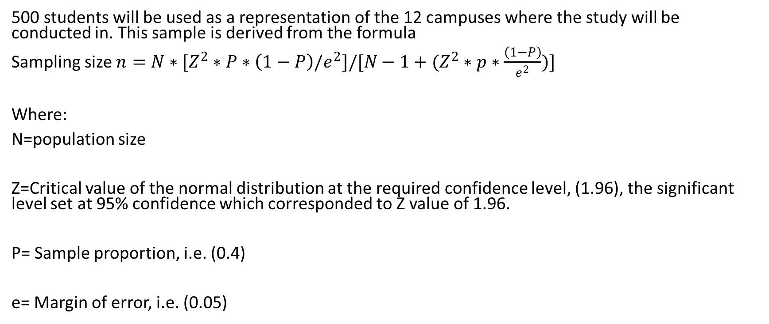
Methodology
500 students will be used as a representation of the 12 campuses where the study will be conducted in. This sample is derived from the formula
Sampling size ${n=N∗[Z}^{2}∗P∗\left(1−P\right)/e^{2}]/[N−1+(Z^{2}∗p∗\frac{\left(1−P\right)}{e^{2}})]$
Where:
N=population size
Z=Critical value of the normal distribution at the required confidence level, (1.96), the significant level set at 95% confidence which corresponded to Z value of 1.96.
P= Sample proportion, i.e. (0.4)
e= Margin of error, i.e. (0.05)

Slide 10
Methodologies Continued…
The system will be developed using the waterfall model of the SDLC.
Data collection will entail the following:
Surveys-Collecting feedback from players
User Testing-Observing players as they play the game to identify areas of difficulty.
Questionnaires- To collect data on what players would like to interact with in the game.
Analytics- This will look at users’ completion rates, time spent on specific levels, etc.
Interviews

Slide 11
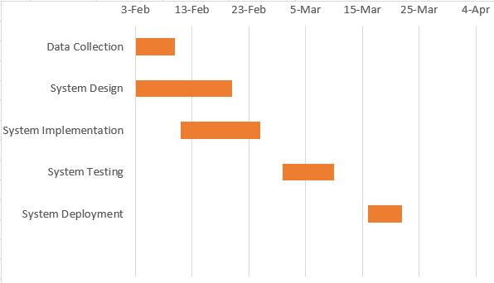
Time Frame and Work Schedule
The development of this game will run from 3rd February 2023 all the way to 4th April 2023.
The SDLC has been shown in form of a Gantt chart

Slide 12
Budget
The researcher is planning to visit at least 12 campuses around Nairobi. The transport cost that will be incurred will be about KSH 150 per campus. This will attract a fee of about KSH 1,800 in total.

Slide 13
References

Slide 14
Thank You

